Slide 1
AndroRisk: Privacy Risk Assessment Tool on Android
Gareth Ripley & Christophe Touret
SE590 Graduate Seminar
Dr. Seker
4/22/2014

Slide 2
Presentation Overview
Project Refresher
Work Performed
TaintDroid TaintLogger Application
TaintDroid PermissionTrigger Application
AndroRisk Application
AndroRisk Risk Assessment Methodology
Issues
Future Work
Conclusions

Slide 3
Project Refresher
Problematic:
Incomplete tools for assessing privacy risk to an Android Phone
State of the Art:
Detection tools
Privacy risk assessment methodologies
Our Contribution:
Uniting risk assessment methodology with the pre-existing sensitive data access/communication detection for assessing privacy risk to an Android Phone.
Notes:
http://www.infosecurity-magazine.com/view/36612/92-of-top-500-android-apps-carry-security-or-privacy-risk/

Slide 4
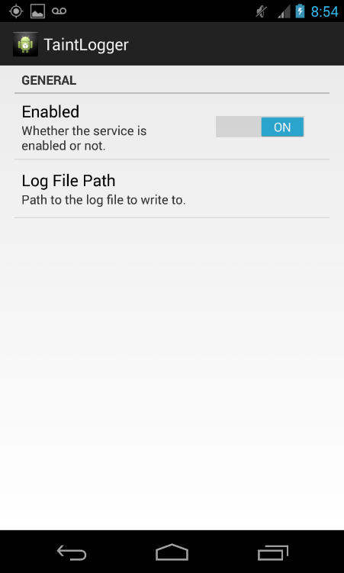
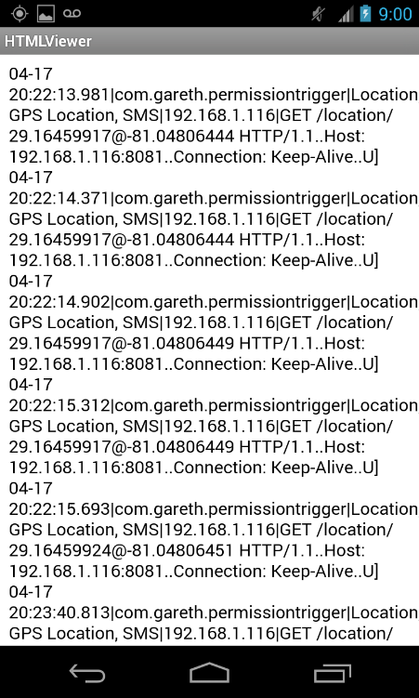
TaintDroid TaintLogger Application
Reads TaintDroid logcat messages
Parses out important data:
Timestamp
Application
Info Sent (Location, SMS, IMEI, etc.)
IP address
Saves each in log file to be read by AndroRisk application.

Slide 5
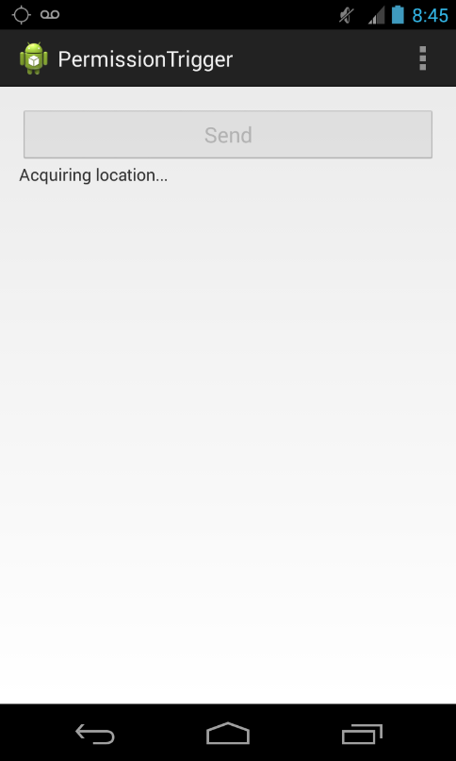
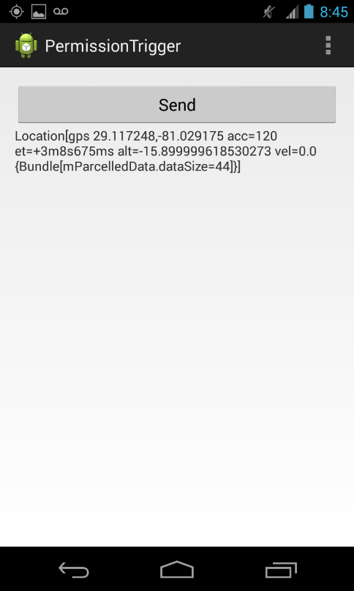
TaintDroid PermissionTrigger Application
Continually reads GPS Location.
Upon selection of Send button:
GPS Location is sent to Server (My PC)
TaintDroid logcat message created.
TaintDroid notification message displayed (if enabled).

Slide 6
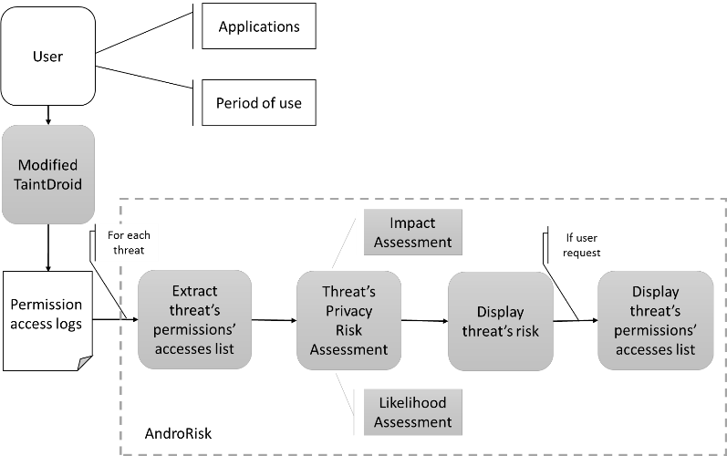
AndroRisk Application
Use the log file for assessing risk for 5 privacy threats

Slide 7
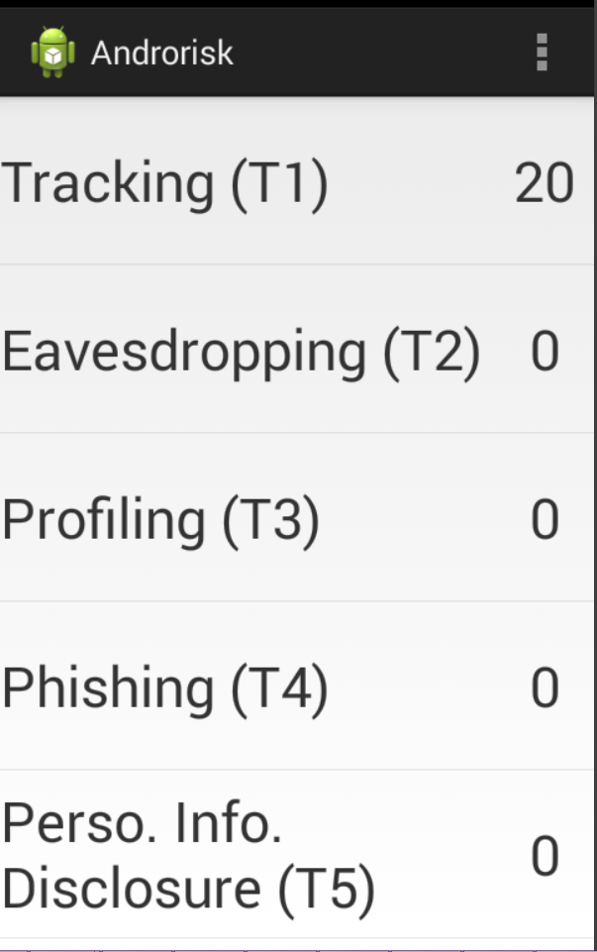
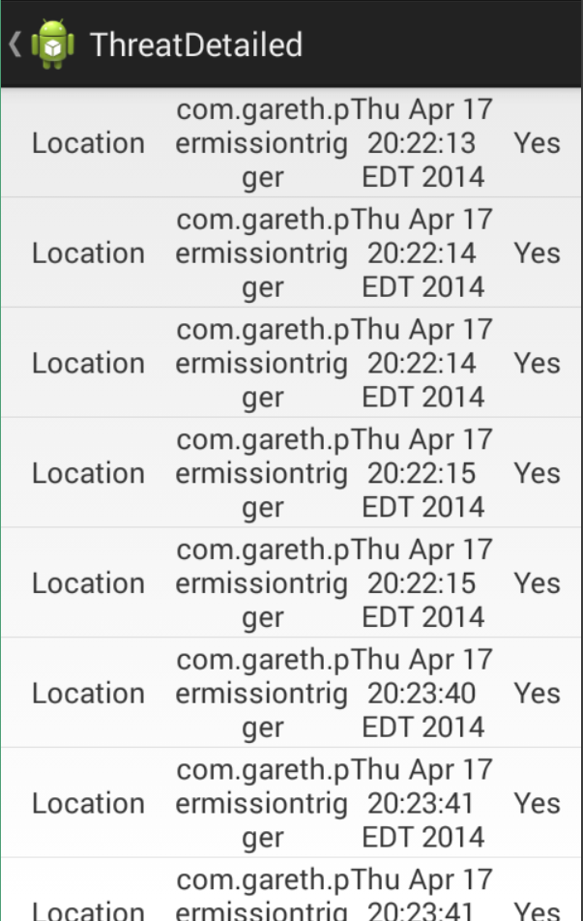
AndroRisk Application (continued)
Privacy risk for each threat
Detailed list of permission accesses

Slide 8

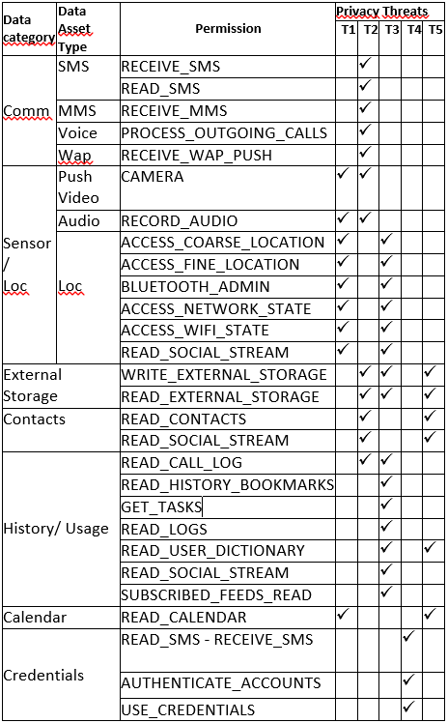
AndroRisk Privacy Risk Assessment Methodology
Risk

Slide 9


AndroRisk Privacy Risk Assessment Methodology (continued)
Impact
Identification Level | Permission
1 | ACCESS_COARSE_LOCATION,ACCESS_FINE_LOCATION, ACCESS_ NETWORK_STATE,ACCESS_WIFI_STATE,BLUETOOTH_ADMIN, GET_TASKS,READ_CALENDAR,READ_HISTORY_BOOKMARKS, READ_LOGS,READ_USER_DICTIONARY,RECEIVE_WAP_PUSH, SUBSCRIBED_FEEDS_READ
2 | CAMERA,PROCESS_OUTGOING_CALLS,READ_CALL_LOG,READ_CO- NTACTS,READ_EXTERNAL_STORAGE,READ_SMS,READ_SOCIAL_ STREAM,RECEIVE_MMS,RECEIVE_SMS,RECORD_AUDIO,WRITE_EXTE RNAL_STORAGE
3 | AUTHENTICATE_ACCOUNTS,GET_ACCOUNTS,USE_CREDENTIALS
4 | READPHONE_STATE,READ_PROFILE
What is important for you ?

Slide 10

AndroRisk Privacy Risk Assessment Methodology (continued)
More the sensitive data are accessed,
more the risk is likely to occur
N(T) is the number of T’s permissions’ accesses per day.
Likelihood

Slide 11
Issues
Time/Schedule constraints
Narrowed down scope of project
Incomplete functionality of what was initially planned (Discussed in Future Work slide)
Unable to trial run on development phone using as daily phone to see real-world analysis results.
Privacy risk assement methodology
Previous study can not be reproduced completely, reuse of the concepts only.
Defining the metrics, the formulas and the constants
Making a code very scalable, a « platform »

Slide 12
Future Work
(optional) Expand PermissionTrigger application to trigger any/all other permissions.
Explore possibility to detect if Application is Active/Background.
Modify TaintDroid to tag secure information with Application Name to determine if secure data has been shared between applications before leaving system.

Slide 13
Future Work (continued)
Complete the tool :
Complete the HashMaps corresponding to the tables of the method
Create the questionary
Make empirical analysis for providing meaning to the risks values
Provide different patterns corresponding to different needs
Readapt the constant values of the formulas.
Enable a reset of the period of use.

Slide 14
Conclusions
Although not 100% complete, we feel we successfully:
Exhibited the feasibility of a user approach for privacy risk assessment.
Suggestion of a method that takes in consideration diverse source of inputs
Created a platform from which future work can be accomplished.
All source code will be provided with our final report submission.

Slide 15
References
“TaintDroid: An Information-Flow Tracking System for Realtime Privacy Monitoring on Smartphones” by William Enck, Peter Gilbert and Byung-Gon Chun
“Assessing privacy risks in Android: A user-centric approach” by Alexios Mylonas, Marianthi Theoharidou, and Dimitris Gritzalis

Slide 16
QUESTIONS?

